Slide 1
Lecture 13 Superscalar Courtesy of A. Shrivastava (ASU) & Tack-Don Han (Yonsei)
Computer Architecture-Module5
Department of Computer Science
Kyoungwoo Lee

Slide 2
Where are we and where to?
Assembly Language
Simple Processor Design
Pipelined Processor
Memory Hierarchy
Out-of-Order Execution
Register Scoreboarding
Register Renaming
Superscalar
Multithreading
Manycores
Accelerators

Slide 3
Agenda
Superscalar Organization
(Recall) Dependency
Out-of-order Completion
Register Renaming
Branch Prediction

Slide 4
Superscalar Organization
Superscalar Machine

Slide 5
What is Superscalar?
A Superscalar machine executes multiple independent instructions in parallel
They are pipelined as well.
“Common” instructions (arithmetic, load/store, conditional branch) can be executed independently
Equally applicable to RISC & CISC, but more straightforward in RISC machines
The order of execution is usually assisted by the compiler

Slide 6
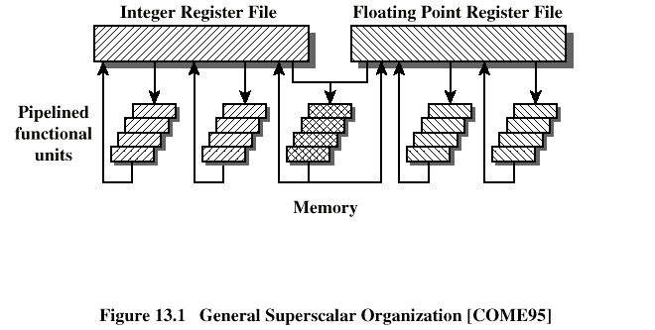
Example of Superscalar Organization
Integer Register File
Floating Point Register File
Pipelined functional units
Memory
2 Integer ALU pipelines,
2 FP ALU pipelines,
1 memory pipeline

Slide 7
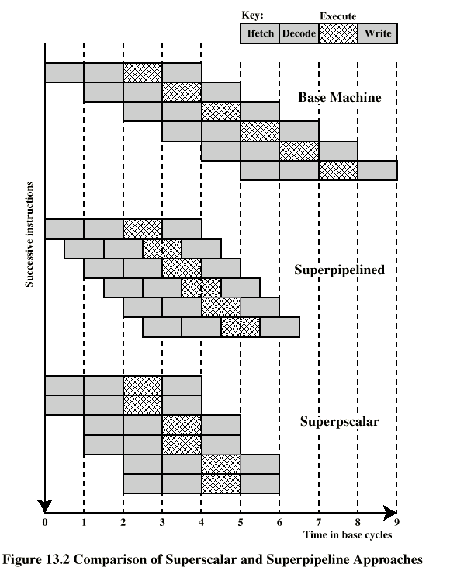
Superscalar vs. Superpipelined
Base machine
Key:
Successive instructions
Ifetch
Write
Superpipelined
Decode
Execute
Superscalar
Time in base cycle

Slide 8
(Recall) Dependency
Superscalar Machine

Slide 9
(Recall)True Data Dependency(Must W before R)
True Dependency
= Data Dependency
= RAW Dependency
ADD r1, r2 r1+r2 → r1
MOVE r3, r1 r1 → r3
Can fetch and decode second instruction in parallel with first
LOAD r1, X X(memory) → r1
MOVE r3, r1 r1→ r3
Can NOT execute second instruction until first is finished
Second instruction is dependent on first (R after W)

Slide 10
(Recall) Antidependancy (Must R before W)
Anti-Dependency
= WAR Dependency
ADD R4, R3, 1 R3 + 1 → R4
ADD R3, R5, 1 R5 + 1 → R3
Cannot complete the second instruction before the first has read R3
ADD R4, R3, 1 R3 + 1 → R4
ADD R4, R5, 1 R5 + 1 → R4
Cannot complete the second write before the first write to R4
Output Dependency
= WAW Dependency

Slide 11
(Recall) Control Dependency
Cannot execute instructions after a branch
in parallel with instructions before a branch, because….?
Note: Also, if instruction length is not fixed, instructions have to be decoded to find out how many fetches are needed

Slide 12
(Recall) Resource Conflict
Two or more instructions requiring access to the same resource at the same time
e.g. two arithmetic instructions need the ALU
Solution - Can possibly duplicate resources
e.g. have two arithmetic units

Slide 13
Effect of Dependencies on Superscalar Operation
Ifetch
Decode
Execute
Write
i0
No Dependency
i1
Notes:
Superscalar operation is double impacted by a stall
2) CISC machines typically have different length instructions and need to be at least partially decoded before the next can be fetched – not good for superscalar operation
Data Dependency (i1 uses data computed by i0)
i0
i1
i0
Procedural Dependency
i1/branch
i2
i3
i4
i5
Resource conflict
(i0 and i1 use the same functional unit)
i0
i1
0 1 2 3 4 5 6 7 8 Time in base cycles

Slide 14
Instruction-level Parallelism – degree of
Consider:
LOAD R1, R2
ADD R3, 1
ADD R4, R2
These can be handled in parallel
Consider:
ADD R3, 1
ADD R4, R3
STO (R4), R0
These cannot be handled in parallel
The “degree” of instruction-level parallelism is determined by the number of instructions that can be executed in parallel without stalling for dependencies

Slide 15
Out-of-order Completion
Superscalar Machine

Slide 16
Instruction Issue Policies
Order in which instructions are fetched
Order in which instructions are executed
Order in which instructions update registers and memory values (order of completion)

Slide 17
In-Order Issue / In-Order Completion (e.g.)
Assume:
I1 requires 2 cycles to execute
I3 & I4 conflict for the same functional unit
I5 depends upon value produced by I4
I5 & I6 conflict for a functional unit
Cycle
Decode
Execute
Write
1
2
3
4
5
6
7
8
I1 | I2
I3 | I4
I3 | I4
 | I4
I5 | I6
 | I6
I1 | I2
I1
 |  | I3
 |  | I4
 | I5
 | I6
I1 | I2
I3 | I4
I5 | I6

Slide 18
In-Order Issue / Out-of-Order Completion (e.g.)
Again:
I1 requires 2 cycles to execute
I3 & I4 conflict for the same functional unit
I5 depends upon value produced by I4
I5 & I6 conflict for a functional unit
Cycle
Decode
Execute
Write
1
2
3
4
5
6
7
8
I1 | I2
I3 | I4
 | I4
I5 | I6
 | I6
I1 | I2
I1 |  | I3
 |  | I4
 | I5
 | I6
I2
I1 | I3
I4
I5
I6
How does this effect interrupts?

Slide 19
Register Renaming
Superscalar Machine

Slide 20
Register Renaming to avoid hazards
Output and antidependencies occur because register contents may not reflect the correct ordering from the program
Can require a pipeline stall
One solution: Allocate Registers dynamically (renaming registers)

Slide 21
Register Renaming example
Add R3, R3, R5 R3b:=R3a + R5a (I1)
Add R4, R3, 1 R4b:=R3b + 1 (I2)
Add R3, R5, 1 R3c:=R5a + 1 (I3)
Add R7, R3, R4 R7b:=R3c + R4b (I4)
Without “subscript” refers to logical register in instruction
With subscript is hardware register allocated: R3a R3b R3c
Note: R3c avoids: antidependency on I2 output dependency I1

Slide 22
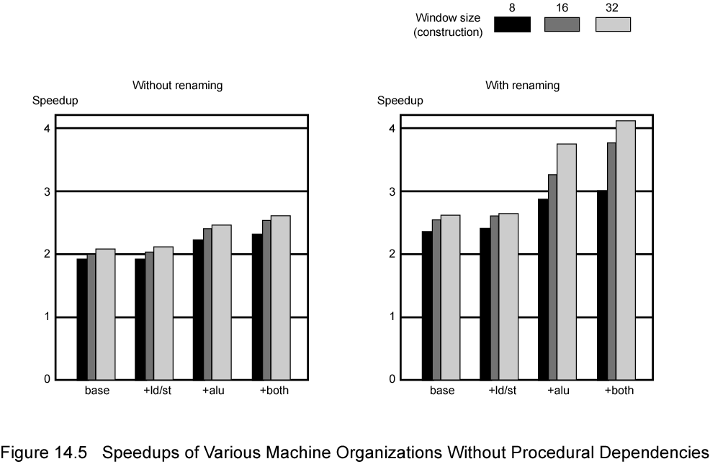
Speedups of Machine Organizations
Not worth duplication of functional units without register renaming
Need instruction window large enough (more than 8, probably not more than 32)
Without renaming
With renaming
8
16
32
Speedup
Speedup
Window size (construction)
Base +Id/st +alu +both
Base +Id/st +alu +both

Slide 23
Branch Prediction
Superscalar Machine

Slide 24
Branch Prediction in Superscalar Machines
Delayed branch slot not used much
Multiple instructions need to execute in the delay slot
This leads to too much complexity in recovery
Branch prediction should be used
Branch history is very useful

Slide 25
View of Superscalar Execution
Instruction
dispatch
Instruction
issue
Static Program
Instruction
execution
Instruction reorder and commit
Instruction fetch and branch prediction
Window of execution

Slide 26
Committing or Retiring Instructions
Results need to be put into order (commit or retire)
Results sometimes must be held in temporary storage until it is certain they can be placed in “permanent” storage.
either committed or retired/flushed
Temporary storage requires regular clean up – overhead – done in hardware.

Slide 27
Superscalar Hardware Support
Facilities to simultaneously fetch multiple instructions
Logic to determine true dependencies involving register values and Mechanisms to communicate these values
Mechanisms to initiate multiple instructions in parallel
Resources for parallel execution of multiple instructions
Mechanisms for committing process state in correct order

Slide 28
Summary
Scalar vs. Superscalar vs. Superpipelined
Dependency, OoO Completion, Register Renaming, Branch Prediction, etc. in Superscalar Machines
Next: SIMD and Vector Processors

